Slide 1

Data Extraction from Non-Relational Databases
Querying non-tabular databases: key differences and tools
Notes:
In this presentation, we will explore how to extract data from non-relational or NoSQL databases. We will cover the key differences between relational and non-relational databases, the types of NoSQL databases, and key NoSQL databases. We will dive into querying data from NoSQL databases, handling non-relational data extraction challenges, and the tools for data extraction from NoSQL databases.

Slide 2
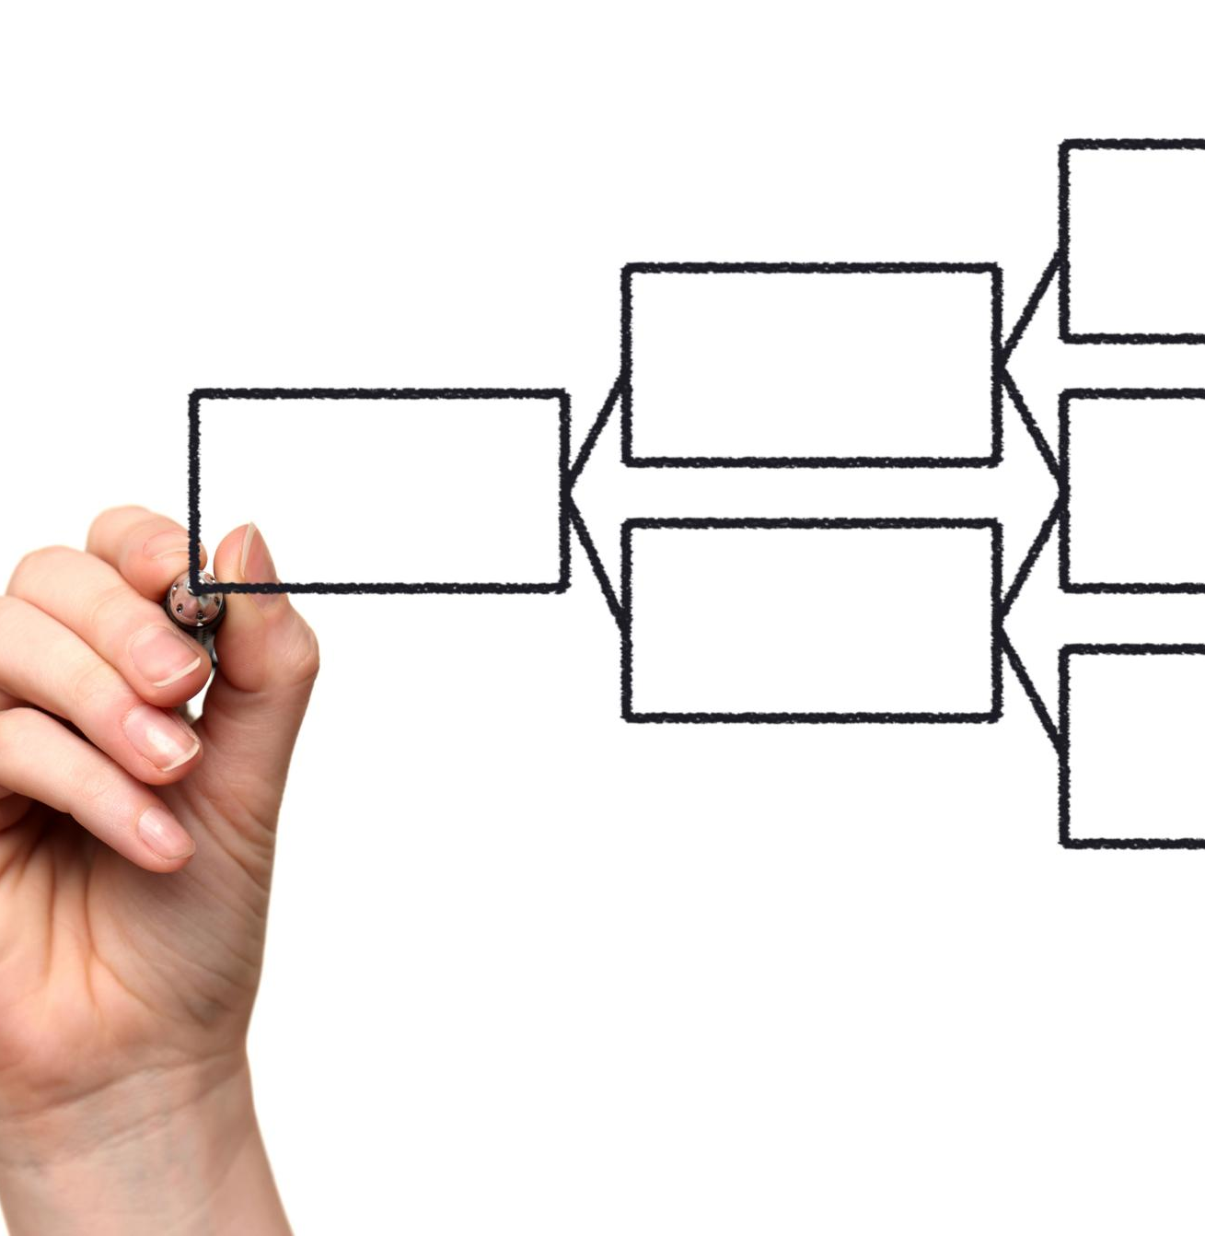
Agenda Items
Overview of Non-Relational Databases (NoSQL)
Key NoSQL Databases
Querying Data from NoSQL Databases
Handling Non-Relational Data Extraction Challenges
Tools for Data Extraction from NoSQL Databases
Notes:
In this presentation, we will start by discussing the basics of non-relational databases and their differences from traditional relational databases. We will then take a deeper dive into some of the most common NoSQL databases like MongoDB, Cassandra, and Couchbase. We will cover querying data from NoSQL databases and the challenges that come along with non-relational data extraction. Finally, we will discuss the various tools that aid us in extracting data from NoSQL databases.

Slide 3
Overview of Non-Relational Databases (NoSQL)
Notes:
Non-relational databases or NoSQL databases, as they are commonly known, are a type of database management system that stores data in a non-tabular format. In this section, we will discuss the key differences between relational and non-relational databases and the types of NoSQL databases that exist today, including key-value stores, document stores, column-family stores, and graph databases.

Slide 4
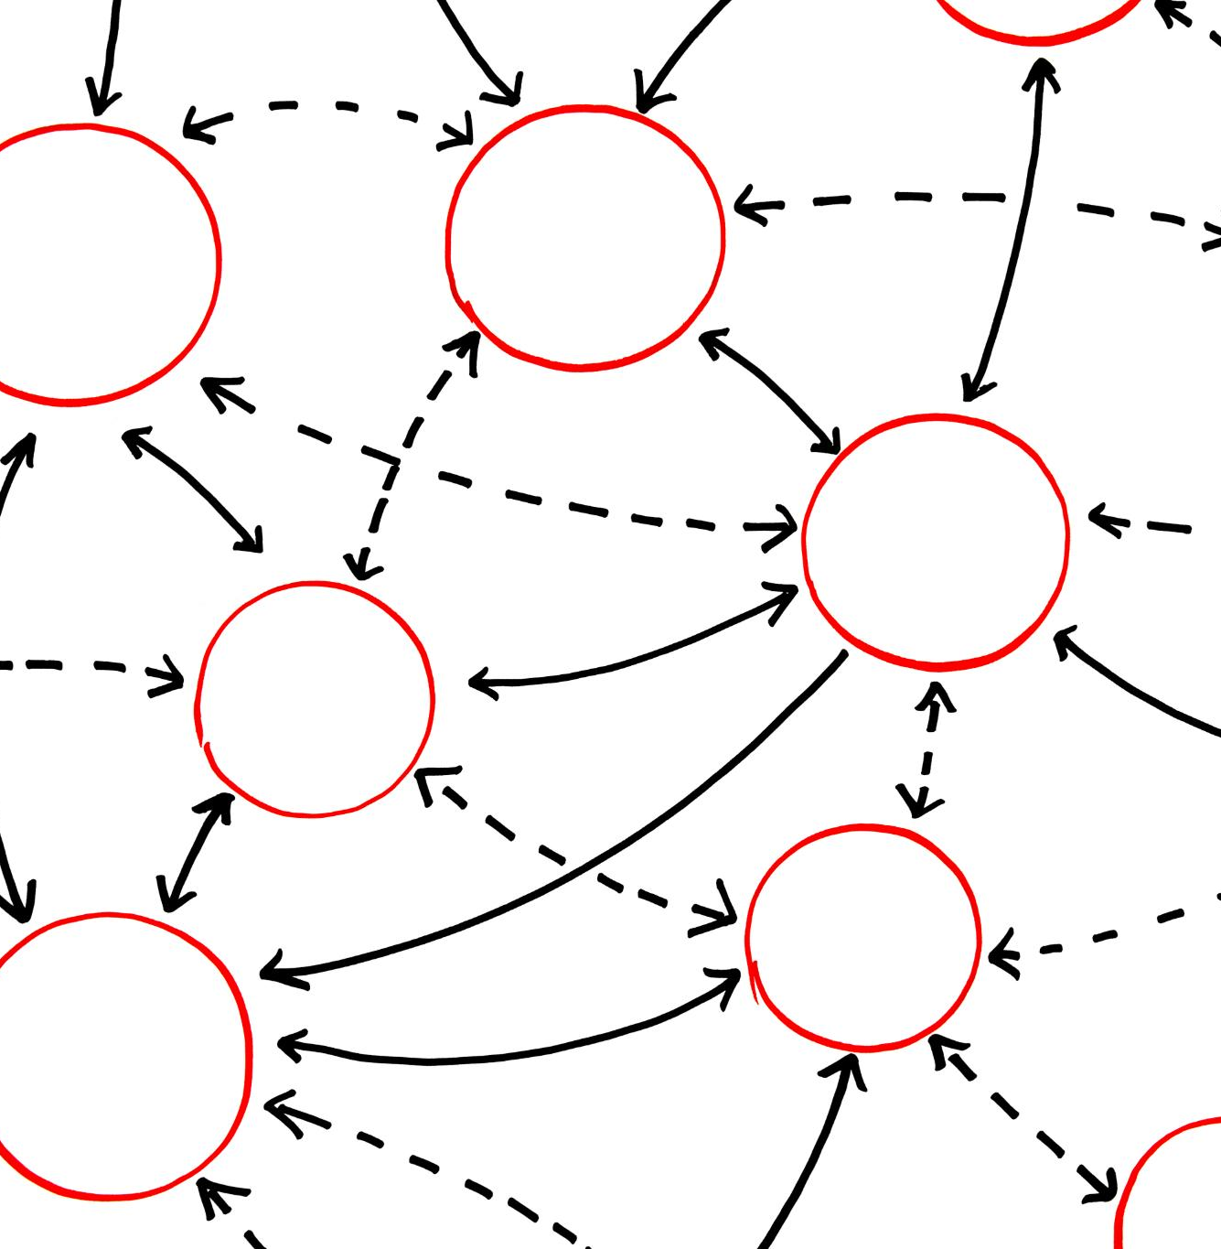
Key differences between relational and non-relational databases
Data Structure
  Relational databases store data in tables with predefined columns and rows, while non-relational databases store data in various formats such as key-value pairs, documents and graphs.
Data Flexibility
  Non-relational databases are more flexible and can handle unstructured and semi-structured data better than relational databases.
Notes:
Relational databases store data in tables with predefined columns and rows, while non-relational databases store data in various formats such as key-value pairs, documents, and graphs. Non-relational databases are more flexible and can handle unstructured and semi-structured data better than relational databases.

Slide 5
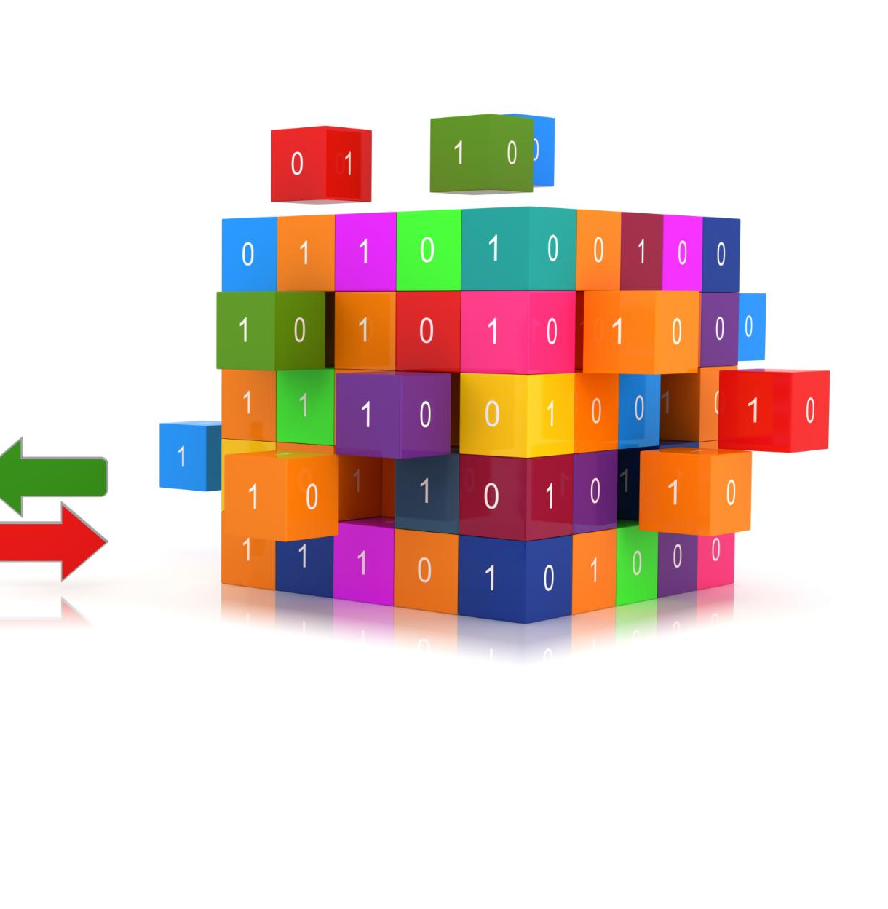
Types of NoSQL databases
Key-Value Stores
  Key-value stores are NoSQL databases that store data as key-value pairs and provide fast read and write performance. They are good for handling large amounts of data with a simple data model.
Document Stores
  Document stores are NoSQL databases that store data in flexible, semi-structured documents such as JSON or XML. They are good for handling unstructured data and can scale horizontally.
Notes:
NoSQL databases can be classified into four categories: key-value stores, document stores, column-family stores, and graph databases. Each type of NoSQL database has its strengths and weaknesses, and organizations choose the type that best fits their needs.

Slide 6
Key NoSQL Databases
Notes:
In this section, we will discuss some of the most commonly used NoSQL databases like MongoDB, Cassandra, Couchbase, and DynamoDB. We will also explore the use cases for NoSQL databases like scalability and flexibility.

Slide 7

MongoDB, Cassandra, Couchbase, DynamoDB
MongoDB
  MongoDB is a popular document store database that provides a flexible and scalable solution for managing complex data structures.
Cassandra
  Cassandra is a column-family store database that can handle large amounts of data and has high availability, making it an ideal solution for big data applications.
Couchbase
  Couchbase is a highly performant key-value store database that is easy to use and widely adopted for its scalability and low latency access to data.
DynamoDB
  DynamoDB is a highly scalable key-value store database that is designed for low latency access to data, making it an ideal choice for real-time applications.
Notes:
MongoDB is a document store database that is widely used for its flexibility and scalability. Cassandra is a column-family store database that can handle large amounts of data and has high availability. Couchbase is a key-value store database that is widely used for its high performance and ease of use. DynamoDB is a key-value store database that is highly scalable and provides low latency access to data.

Slide 8
Querying Data from NoSQL Databases
Notes:
In this section, we will discuss how to query data from NoSQL databases. We will cover the query languages used for NoSQL databases like MongoDB's query language and Cassandra CQL. We will also explore how to extract data from document databases like MongoDB, key-value stores like Redis and DynamoDB, and column-family databases like Cassandra and HBase.

Slide 9

Using Query Languages for NoSQL: MongoDB’s Query Language, Cassandra CQL
Query Languages for NoSQL
  Query languages for NoSQL databases like MongoDB's query language and Cassandra CQL allow us to retrieve and manipulate data from the database. However, their syntax and data retrieval mechanisms are different from SQL.
MongoDB’s Query Language
  MongoDB's query language is a flexible and powerful query language that allows us to perform complex queries on a MongoDB database. It uses a JSON-like syntax and supports many data types and operators.
Cassandra CQL
  Cassandra CQL is a query language that allows us to perform data retrieval and manipulation operations on a Cassandra database. It uses a SQL-like syntax and supports various data types and operators.
Notes:
Query languages for NoSQL databases like MongoDB's query language and Cassandra CQL are similar to SQL in that they allow us to retrieve and manipulate data from the database. However, these query languages have their syntax and data retrieval mechanisms that are suited for their respective databases.

Slide 10

Extracting data from document databases: MongoDB
  MongoDB stores data in documents, which are similar to JSON objects. These documents can be queried using various operators and methods to extract data from MongoDB databases.
Notes:
In MongoDB, data is stored in documents, which are similar to JSON objects. We can use various operators and methods to extract data from MongoDB databases.

Slide 11

Extracting data from key-value stores: Redis, DynamoDB
Key-Value Stores
  Key-value stores such as Redis and DynamoDB are simple but powerful databases that can store large amounts of data in key-value pairs, making them a popular choice for many applications.
Data Extraction
  There are various APIs available to extract data from key-value stores like Redis and DynamoDB. These APIs allow developers to retrieve data and use it in their application.
Notes:
Key-value stores like Redis and DynamoDB are simple but powerful databases that can store large amounts of data in key-value pairs. We can use various APIs to extract data from these databases.

Slide 12

Extracting data from column-family databases: Cassandra, HBase
  Column-family stores like Cassandra and HBase are designed to handle large amounts of data and offer high availability. We can use CQL in Cassandra and APIs for HBase to extract data from these databases.
Notes:
Column-family stores like Cassandra and HBase can handle large amounts of data and have high availability. We can use CQL in Cassandra and APIs for HBase to extract data from these databases.

Slide 13
Handling Non-Relational Data Extraction Challenges
Notes:
In this section, we will discuss some of the challenges that come along with non-relational data extraction. We will cover indexing and performance tuning in NoSQL databases and working with unstructured and semi-structured data in NoSQL.

Slide 14

Indexing and Performance Tuning in NoSQL Databases
Indexing
  Indexing is a technique used to speed up data retrieval in NoSQL databases by creating indexes for frequently used fields. It helps in filtering and sorting data quickly and efficiently.
Partitioning and Sharding
  Partitioning and sharding are techniques used to improve data availability, performance, and scalability in NoSQL databases by breaking up data into smaller partitions or shards and distributing it across multiple nodes or clusters.
Caching
  Caching is a technique used to improve the performance of NoSQL databases by storing frequently accessed data in fast access memory, such as RAM. This reduces the number of times data needs to be retrieved from disk, resulting in faster data access and retrieval.
Notes:
Indexing and performance tuning are crucial for efficient retrieval of data from NoSQL databases. We can use various techniques to optimize the performance of NoSQL databases.

Slide 15

Working with unstructured and semi-structured data in NoSQL
  NoSQL databases are designed to handle unstructured and semi-structured data, which makes them a better choice for modern applications. Working with such data requires special techniques and skills, which we explore in this section.
Notes:
NoSQL databases are better suited for handling unstructured and semi-structured data than relational databases. However, working with such data requires special skills and techniques that we will explore in this section.

Slide 16
Tools for Data Extraction from NoSQL Databases
Notes:
In this section, we will discuss some of the tools that aid us in extracting data from NoSQL databases. We will cover using APIs for MongoDB, Cassandra, and other databases. We will also explore integration tools like Apache NiFi and Talend for NoSQL databases.

Slide 17

Using APIs for MongoDB, Cassandra
  APIs for NoSQL databases like MongoDB and Cassandra allow us to easily extract data from these databases, giving us the ability to retrieve and manipulate data in various ways.
Notes:
APIs for NoSQL databases like MongoDB and Cassandra make it easy to extract data from these databases. We can use APIs to retrieve data and manipulate it in various ways.

Slide 18
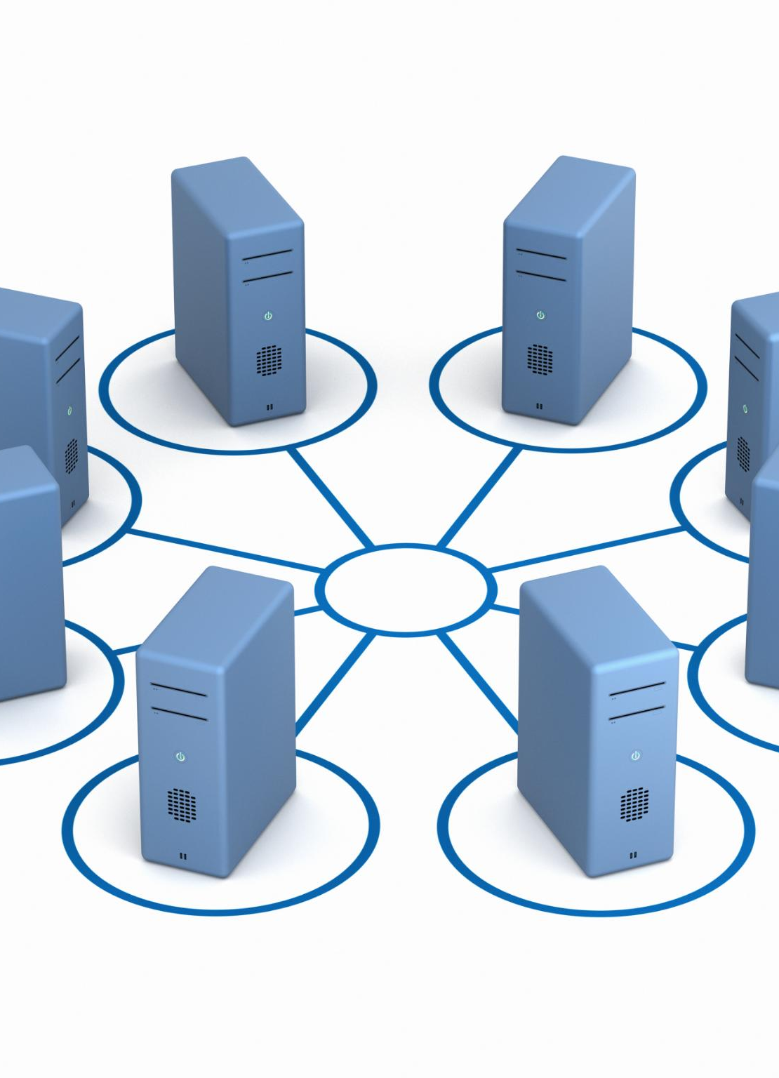
Integration tools like Apache NiFi, Talend for NoSQL databases
Apache NiFi
  Apache NiFi is an open-source data integration tool that makes it easy to extract data from NoSQL databases and integrate it with other tools and systems. It provides a wide range of features and functionalities that make data extraction and integration easier.
Talend
  Talend is a popular data integration tool that makes it easy to extract data from NoSQL databases and integrate it with other tools and systems. It provides a wide range of features and functionalities that make data extraction and integration easier.
Notes:
Integration tools like Apache NiFi and Talend make it easy to extract data from NoSQL databases and integrate it with other tools and systems. These tools provide a wide range of features and functionalities that make data extraction and integration easier.

Slide 19
Conclusion
  Extracting data from non-relational or NoSQL databases can be challenging, but it is essential for organizations that want to harness the power of these databases. In this presentation, we covered the basics of NoSQL databases, key NoSQL databases, querying data from NoSQL databases, handling non-relational data extraction challenges, and the tools for data extraction from NoSQL databases.
Notes:
Extracting data from non-relational or NoSQL databases can be challenging, but it is a critical task for organizations that want to harness the power of these databases. In this presentation, we covered the basics of NoSQL databases, key NoSQL databases, querying data from NoSQL databases, handling non-relational data extraction challenges, and the tools for data extraction from NoSQL databases.

